Slide 1
Sports Analytics – Cricket Indian Premier League (IPL)
CS5100
Alessandro Eppacher & Kshitij Aggarwal

Slide 2

Indian Premier League
Annual cricket tournament with ‘random’ distribution of players
145 players with max team size of 25
8 teams play in round robin stage, one away and one home game
Top 4 teams qualify for double elimination playoffs
prize pool of ~6 million
Team salary cap of ~12 million
Pick the best team

Slide 3
Problem Statement
Using Machine Learning and game statistics we intend to predict Win or Loss for a cricket IPL match.
Using dataset from kaggle, available in detail for each game across 10 seasons.
We will be using the last season as the test set to actually know how well our model performs.

Slide 4
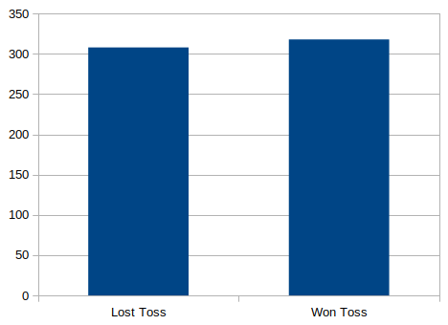
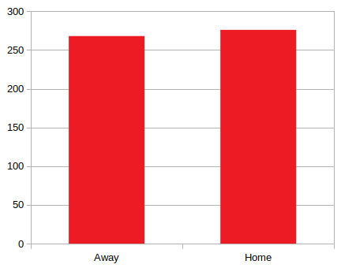
Exploratory Analysis - initial thoughts
home field advantage and coin toss advantage surprisingly low impact <5%
little to no correlation for things like umpires and game/score outcome

Slide 5
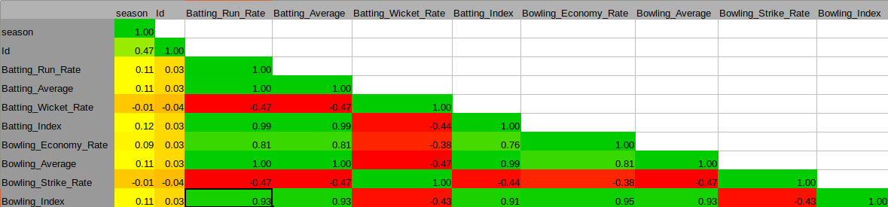
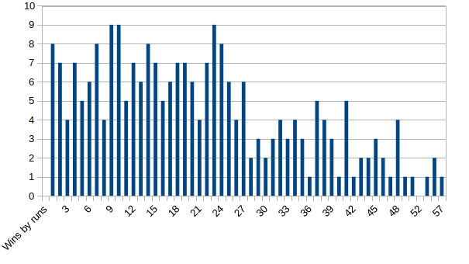
Exploratory Analysis
obviously high score rates correlated to win
good offense is correlated with a good defense. Runs conceded negatively correlated to batting economy (-.57 not pictured)
match outcomes are more likely closer (run differential of 25 or less)
most landslide games are the result of team with different bowling economies

Slide 6
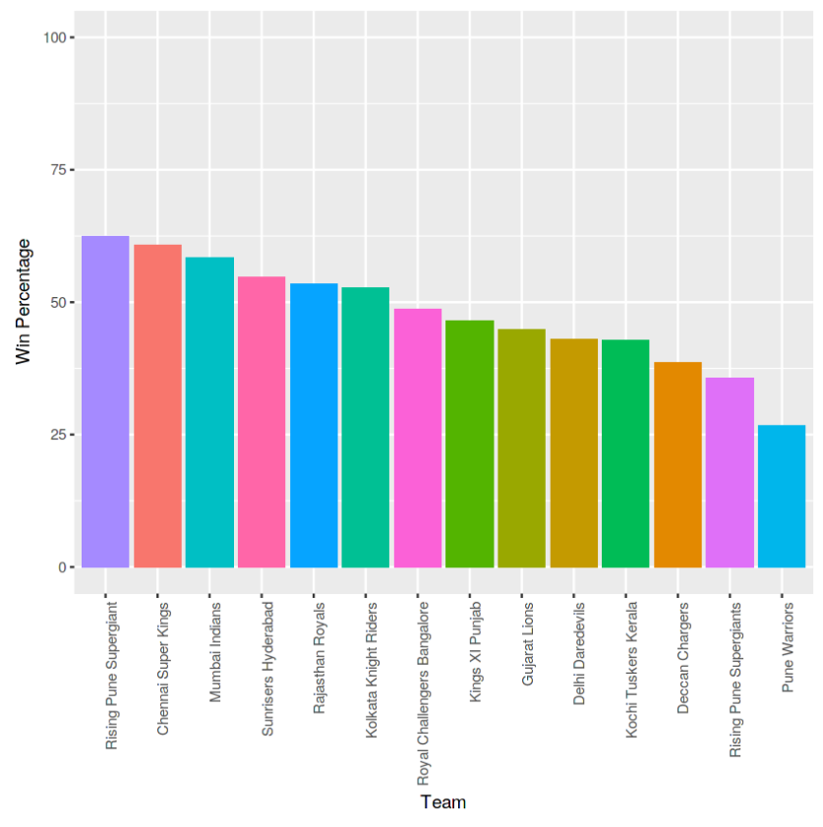
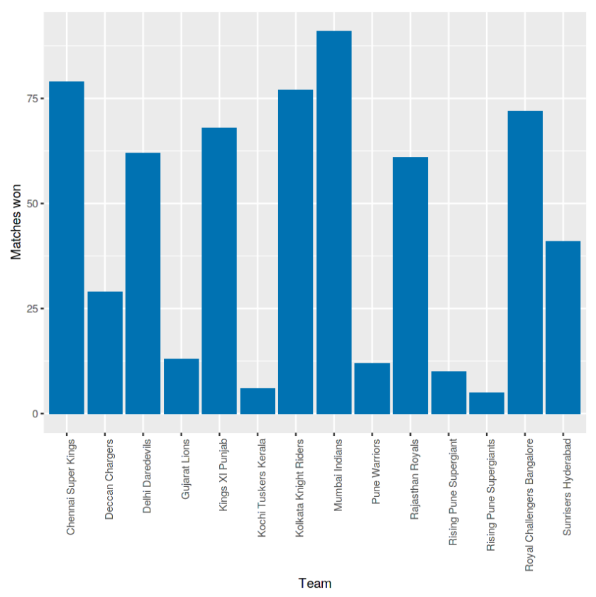
Exploratory Analysis
images from https://www.kaggle.com/vamsikrishna/exploratory-data-analysis-of-ipl-data/notebook
Generally the more matches a team has played the higher their win rate with Rising Pune Supergiant being main exception
Teams will often find success with different players

Slide 7
Problem Formulation
We had the following data points (35):
Season, city, date, team1, team2, toss_winner, toss_decision, result, winner win_by_runs, win_by_wickets, player_of_match, venue, umpire1, umpire2 and umpire3.
Inning, batting_team, bowling_team, over, ball, batsman, non_striker, bowler, is_super_over, wide_runs, bye_runs, legbye_runs, noball_runs, penalty_runs, batsman_runs, extra_runs total_runs, player_dismissed, dismissal_kind.
We then transformed and aggregated to 17 features and 1 dependent variable ‘Winner’
Team1_Batting_Run_Rate, Team1_Batting_Average, Team1_Batting_Wicket_Rate, Team1_Batting_Index, Team2_Batting_Run_Rate, Team2_Batting_Average, Team2_Batting_Wicket_Rate, Team2_Batting_Index, Team1_Bowling_Economy_Rate, Team1_Bowling_Average, Team1_Bowling_Strike_Rate, Team1_Bowling_Index, Team2_Bowling_Economy_Rate, Team2_Bowling_Average Team2_Bowling_Strike_Rate, Team2_Bowling_Index

Slide 8
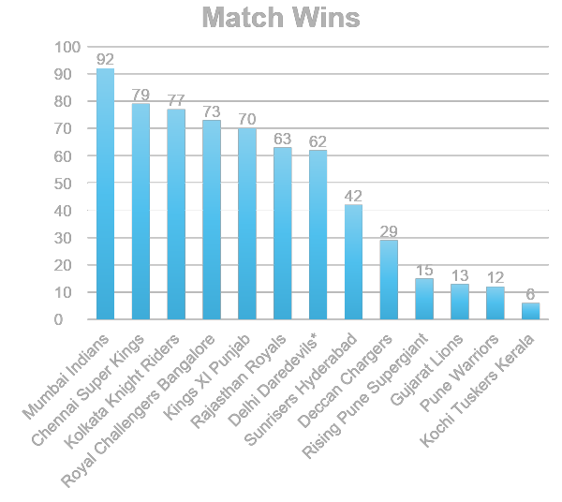
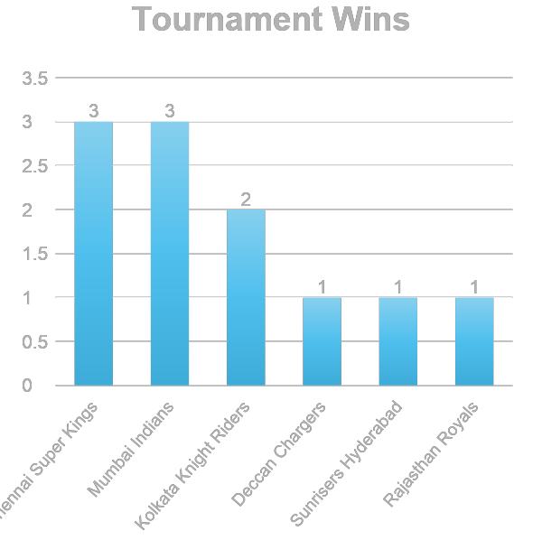
Game Overview
*Now Delhi Capitals

Slide 9
Algorithms Used (with/without PCA*)
Our results varied a lot across all these algorithms.
We used PCA* for dimensionality reduction and managed two reduce the features to 15.
Data split 75% - 25% (Seasons 2008 – 2016)
Validation Set (Season 2017)
Highest accuracy achieved is with 57.7%.
*Principal Component Analysis
Random Forest
Decision Tree
Logistic Regression
kNN

Slide 10
Further Steps
Moving forward we will be applying Ensemble methods to see if we can improve our accuracy.
Additionally, we will explore Support vector clustering
Ensemble methods
SVC

Slide 11
Questions?
**Suggestions are most welcome!

